Slide 1
Week 1
10-06-2022
Parth Deshpande

Slide 2
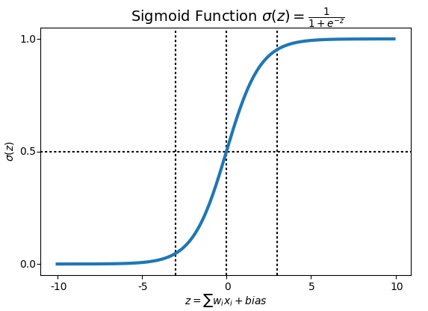
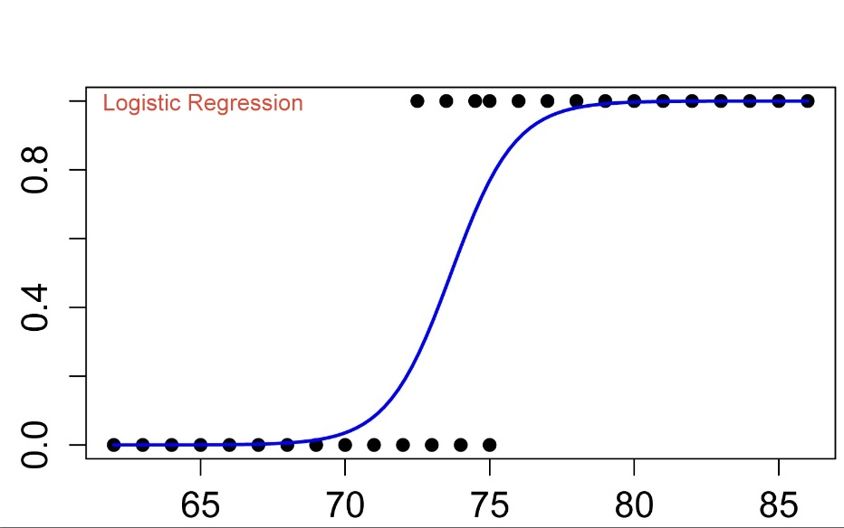
Logistic Regression with a Neural Network mindset
Logistic regression is a method to predict a binary outcome, such as yes or no, based on prior observations of a data set.
In order to map predicted values to probabilities, we use the Sigmoid function. The function maps any real value into another value between 0 and 1.

Slide 3
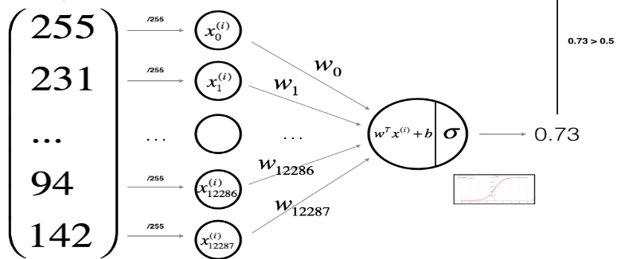
we can think of logistic regression as a one layer neural network. In fact, it is very common to use logistic sigmoid functions as activation functions in the hidden layer of a neural network

Slide 4

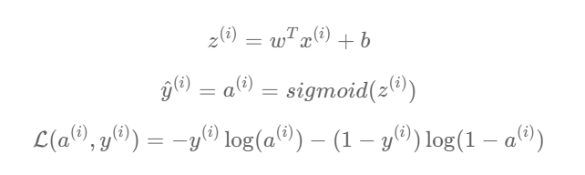

Mathematical expression of the algorithm

Slide 5

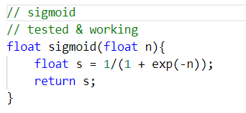
Part-1 Sigmoid

Slide 6
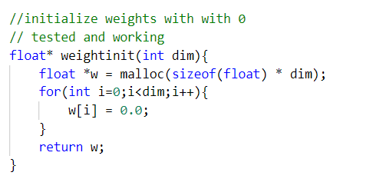
Part-2 Weight initialize with zeros
This function creates a vector of zeros of shape (dim, 1) for w.
Malloc is used to allocate the memory and then return that pointer . If normal float array is used , then the memory allocated to that local array is deallocated when function call ends.

Slide 7
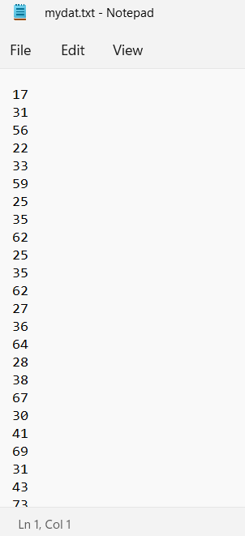
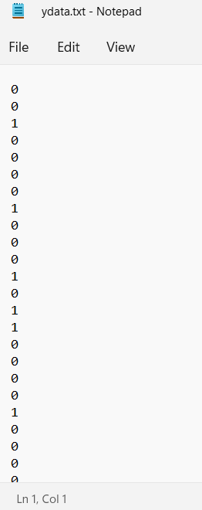
Training Data – input features and y - labels
static float x_train[12288][50];
static float y_train[50];
static int NoOfEx = 50;
As the available training dataset was in .h5 format ,
I converted it into C-readable format in a .txt file with pixel values in each newline
Group of 12288 pixels(every 12288 lines in text file)
represent (64 x 64 x 3) image and corresponding 0/1 label

Slide 8
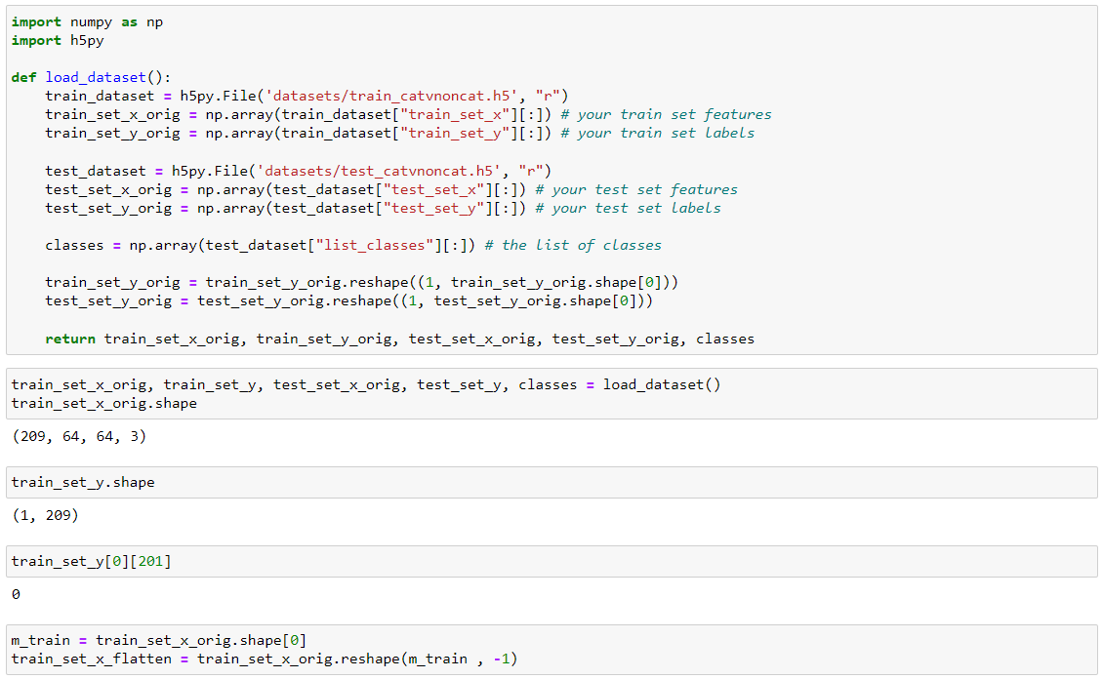

Slide 9
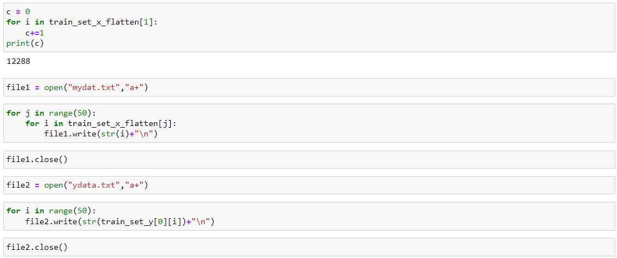

Slide 10
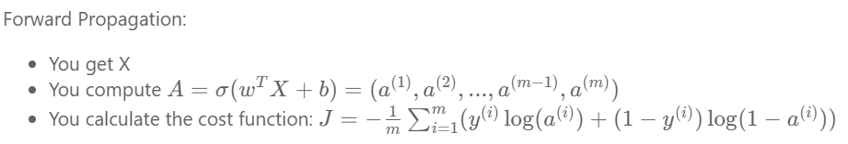
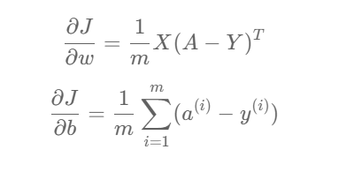
Part-3 Forward and Backward propagation
For backward propagation partial derivatives,
w -- weights, an array of size (num_px * num_px * 3, 1)
b -- bias, a scalar
X -- data of size (num_px * num_px * 3, number of examples)
Y -- true "label" vector (containing 0 if non-cat, 1 if cat) of size (1, number of examples)

Slide 11
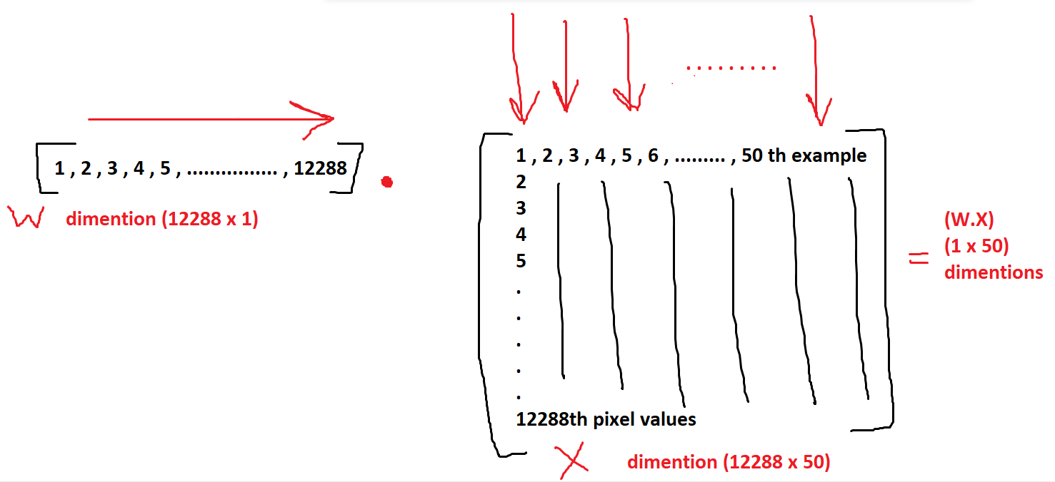

Slide 12
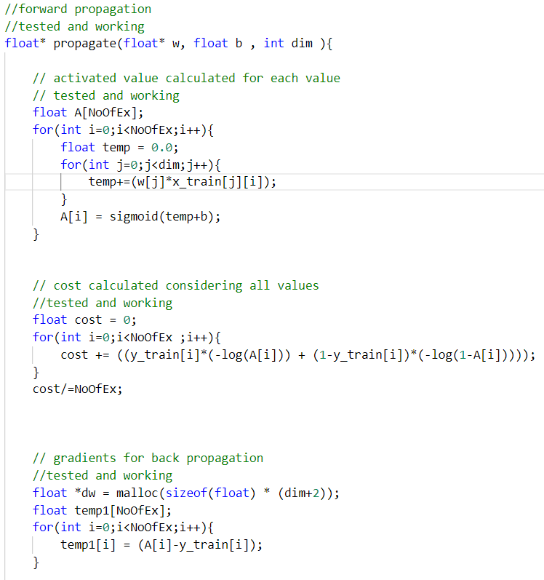

Slide 13
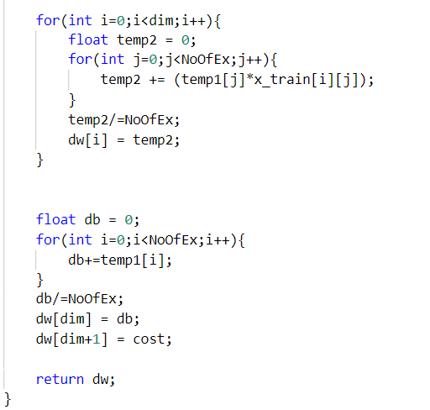
Return:
cost -- negative log-likelihood cost for logistic regression
dw -- gradient of the loss with respect to w, thus same shape as w
db -- gradient of the loss with respect to b, thus same shape as b

Slide 14
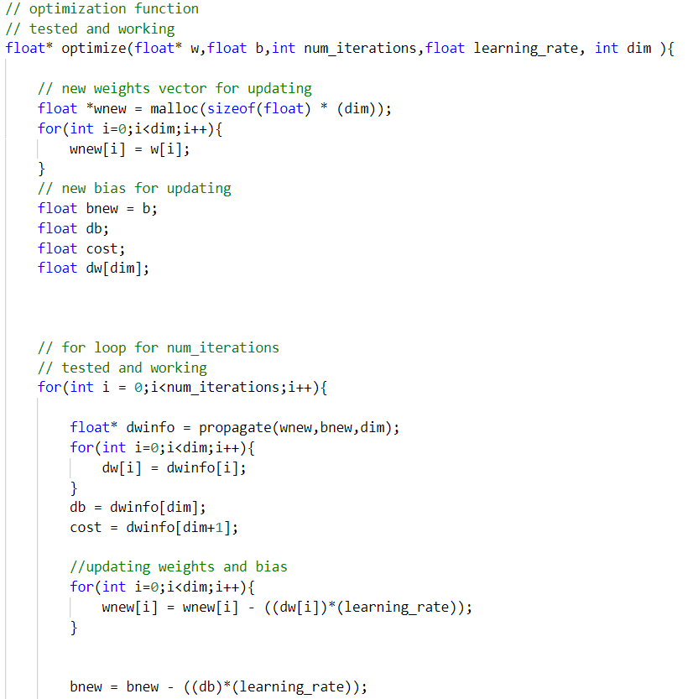
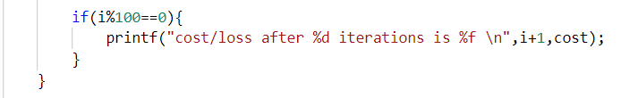
Part-4 Optimization

Slide 15
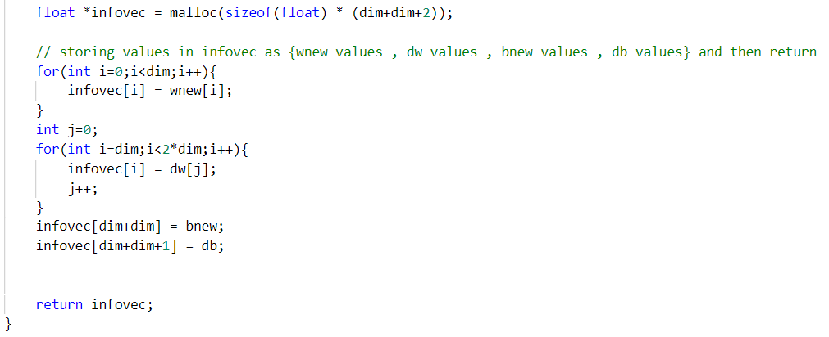

Slide 16
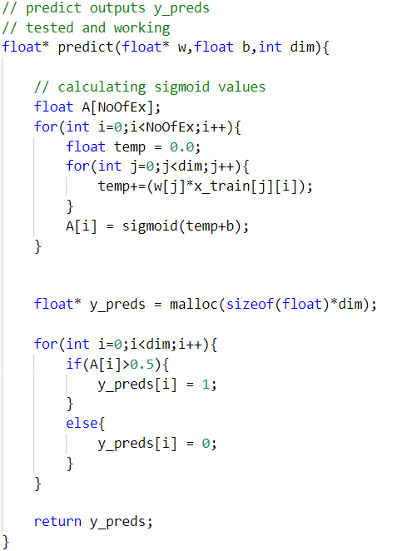
Part-5 Predict

Slide 17
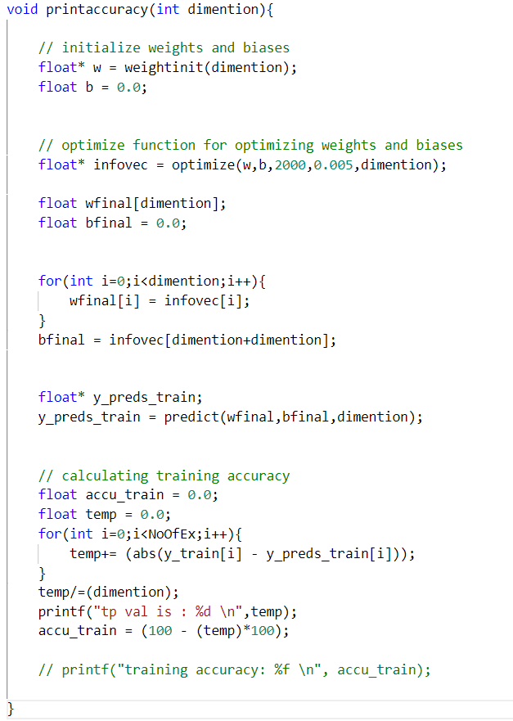
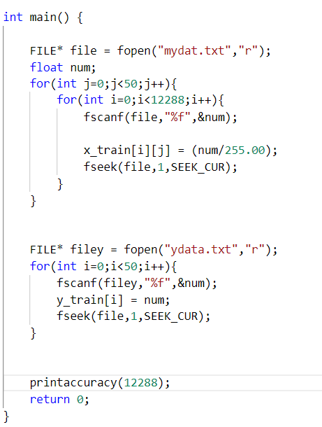

Slide 18
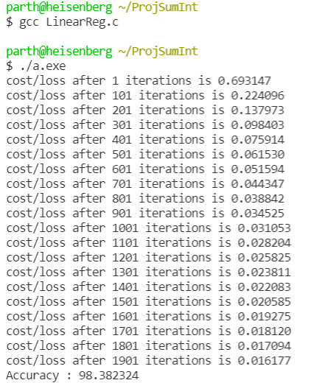

Slide 19
Week 2
20-06-2022
Parth Deshpande

Slide 20
Linear Regression
#include <stdio.h>
#include <stdlib.h>
#include <math.h>
float avgError(float* xdata,float* ydata,int n,float m,float c){
float temp = 0.0;
float pred ;
for(int i=0;i<n;i++){
pred = (xdata[i]*m + c);
temp+= (fabs(ydata[i] - pred))/n;
}
return temp;
}

Slide 21
int main(){
float x,y,m,c,d;
int n = 84;
float sumx=0,sumxsq=0,sumy=0,sumxy=0;
FILE* file = fopen("LinData.txt","r");
float numx;
float numy;
float* ydata = malloc(sizeof(float)*n);
float* xdata = malloc(sizeof(float)*n); for(int i=0;i<n;i++){
fscanf(file,"%f",&numx);
x = numx;
fseek(file,1,SEEK_CUR);
fscanf(file,"%f",&numy);
y = numy;
ydata[i] = numy;
xdata[i] = numx;
sumx=sumx+x;
sumxsq=sumxsq+(x*x);
sumy=sumy+y;
sumxy=sumxy+(x*y); fseek(file,1,SEEK_CUR);
}
d=n*sumxsq-sumx*sumx;
m=(n*sumxy-sumx*sumy)/d;
c=(sumy*sumxsq-sumx*sumxy)/d;
printf("m = %f and c = %f \n",m,c);
float ans = avgError(xdata,ydata,n,m,c);
printf("accuracy : %f ",100.00 - ans*100.00);
free(ydata);
free(xdata);
}

Slide 22
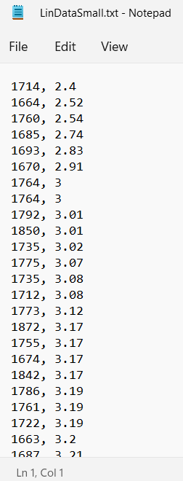
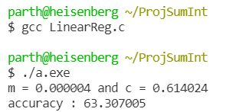
Training Data

Slide 23
Decision tree – Work in progress
#include <stdio.h>
#include <stdlib.h>
#include <math.h>
#include <string.h>
#include <search.h>
struct TableData{
char* FruitColour;
int diam;
char* FruitName;
};
struct StringArray{
char* stringname;
};
// will store the unique strings from labels
static char* temp1[5];
struct StringArray Question(struct TableData train_data[],int cols,int NoOfEx){
struct StringArray questions[cols*NoOfEx];
for(int i=0;i<NoOfEx;i++){
for(int j=0;j<cols;j++){
char* strtemp = train_data[i];
}
}
}

Slide 24
// to calculate number of times the label is repeted
int* class_counts(struct StringArray label_column[], int dim){
for(int i=0;i<dim;i++){
temp1[i] = "#";
}
int curr_pos = 0;
int found;
for(int j=0;j<dim;j++){
found = 0;
for(int i=0;i<dim;i++){
if(strcmp(&label_column[j].stringname,temp1[i])==0){
found = 1;
break;
}
}
if(found == 0){
temp1[curr_pos] = (char*)&label_column[j].stringname;
curr_pos+=1;
}
}
printf("-------------------- \n");
for(int i=0;i<dim;i++){
printf("%s \n",temp1[i]);
}
Decision tree – Work in progress

Slide 25
char* tempstring ;
int* counts_array = malloc(sizeof(int)*dim);
for(int i=0;i<dim;i++){
counts_array[i] = 0;
}
int i = 0;
while(temp1[i]!="#"){
tempstring = temp1[i];
for(int j=0;j<dim;j++){
if(strcmp(tempstring,&label_column[j].stringname)==0){
(counts_array[i])+=1;
}
}
i++;
}
return counts_array;
}
Decision tree – Work in progress

Slide 26
int main(){
// struct TableData train_data[5];
// for(int i=0;i<5;i++){
// scanf("%s",&train_data[i].FruitColour);
// scanf("%d",&train_data[i].diam);
// scanf("%s",&train_data[i].FruitName);
// }
// printf("--------------------- \n");
// for(int i=0;i<5;i++){
// printf("%s \n",&train_data[i].FruitColour);
// printf("%d \n",train_data[i].diam);
// printf("%s \n",&train_data[i].FruitName);
// printf("--------------------- \n");
// }
int NoOfEx = 0;
struct StringArray strings[NoOfEx];
for(int i=0;i<NoOfEx;i++){
scanf("%s",&strings[i].stringname);
}
int* ansvec = class_counts(strings,NoOfEx);
for(int i=0;i<NoOfEx;i++){
printf(" %d \n",ansvec[i]);
}
int cols = 2;
}
Decision tree – Work in progress

Slide 27
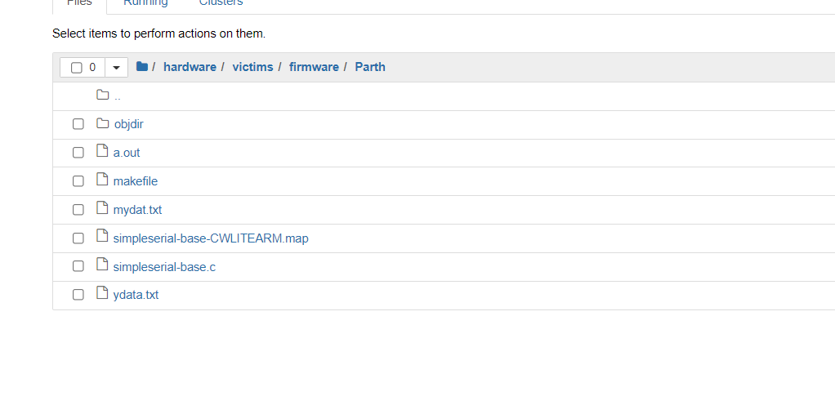
Tested on Chipwhisperer VM gcc

Slide 28
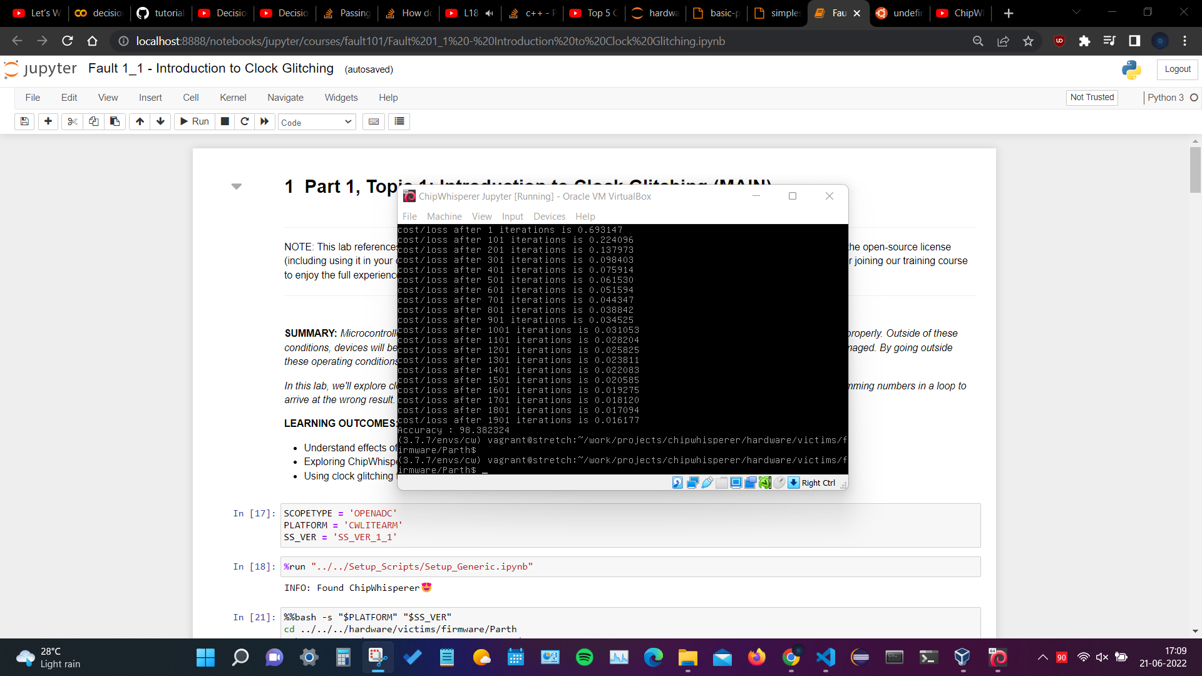

Slide 29
